Slide 1


CAPSTONE PROJECT
PROJECT TITLE
Presented By
Student Name: JUJJAVARAPU RAJA SEKHAR
College Name: P.V.P Siddhartha institute of technology
Department: MBA
Email ID:jujjavarapuraja2002@gmail.com

Slide 2
OUTLINE:
Problem Statement (Should not include solution)
Proposed System/Solution
System Development Approach (Technology Used)
Algorithm & Deployment
Result (Output Image)
Conclusion
Future Scope
References

Slide 3
Problem Statement:
Adani Ports handles large volumes of cargo across multiple regions and ports.
However, it is difficult to:
• Understand cargo distribution across ports
• Compare regional performance
• Analyze customer cargo patterns
• Identify demand trends over time
There is a need for a system to analyze data and provide clear insights for better decision-making.

Slide 4
Proposed Solution:
To solve this problem, a Business Intelligence dashboard is developed using Power BI.
The system helps to:
• Visualize cargo throughput across ports
• Analyze revenue by region
• Understand customer cargo distribution
• Track monthly cargo trends
• Provide statistical insights
• Predict future cargo demand using forecasting
This dashboard makes data easy to understand and supports decision-making.

Slide 5
System Approach:
The system is developed using the following tools:
• Microsoft Excel
- Data cleaning
- Statistical analysis (ANOVA, Chi-square, Forecasting)
• Power BI
- Data visualization
- Dashboard creation
- KPI tracking
• DAX (Data Analysis Expressions)
- Calculations for KPIs
This approach helps to convert raw data into meaningful insights.

Slide 6
Algorithm & Deployment:
Step 1: Collect and clean data in Excel
Step 2: Perform statistical analysis
(Mean, Standard Deviation, ANOVA, Chi-square)
Step 3: Prepare datasets for Power BI
Step 4: Load data into Power BI
Step 5: Create visualizations:
• KPI Cards
• Charts
• Forecast models
Step 6: Build interactive dashboards
Deployment:
The dashboard can be shared through Power BI for business users.

Slide 7
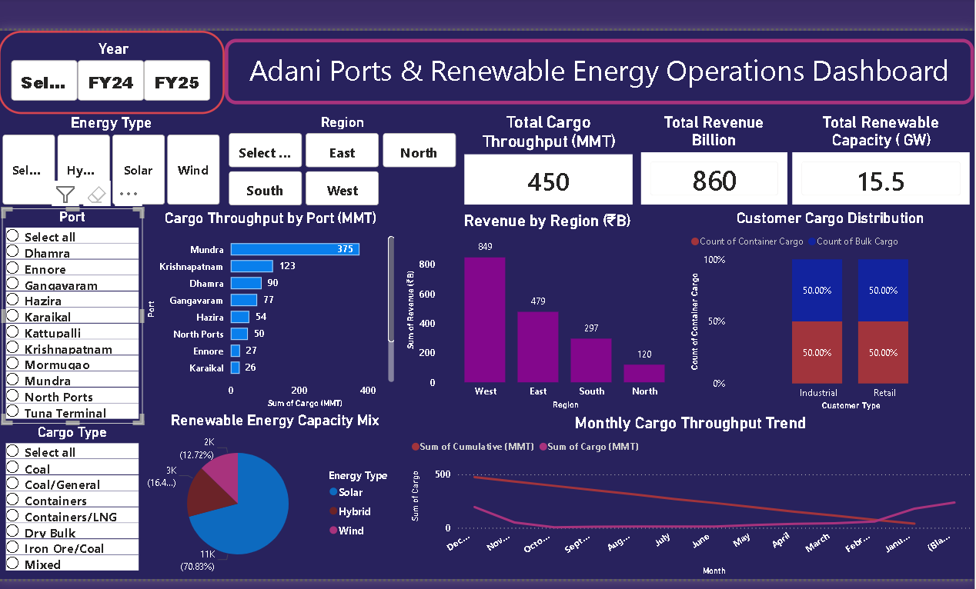
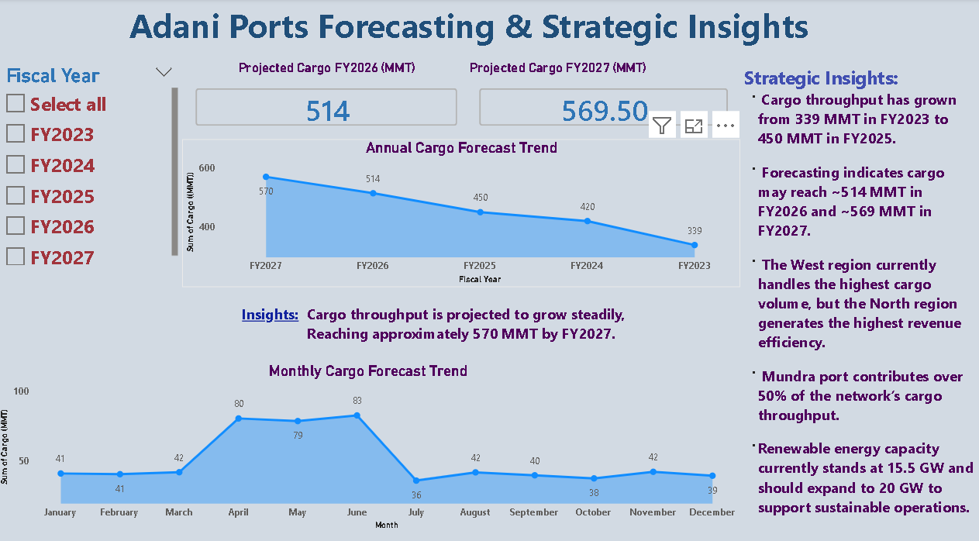
Result:

Slide 8
Conclusion:
This project successfully analyzes Adani Ports data using Power BI.
Key conclusions:
• Cargo throughput is highest at Mundra port
• West region generates the highest cargo and revenue
• Cargo demand is stable around 40 MMT monthly
• Statistical analysis confirms significant differences across regions
• Customer type influences cargo category
The dashboard helps in understanding business performance clearly.

Slide 9
Future scope:
The project can be improved further by:
• Adding real-time data integration
• Using advanced forecasting models (AI/ML)
• Expanding analysis to global ports
• Creating mobile-friendly dashboards
• Adding more financial and operational metrics
This will make the system more powerful and scalable.

Slide 10
References:
• Adani Ports Official Website
• UV Netware Internship Materials
• Microsoft Power BI Documentation
• Microsoft Excel Documentation
• Online resources for statistical analysis GitHub Link: https://github.com/Raja200219/Adani-Ports-Business-Intelligence-Dashboard.git

Slide 11
Thank You

